Slide 1


Time
Is The Most Valuable Asset For Humans

Slide 2
DataScience Middle East
REAL-TIME AND BATCH ANALYTICS PIPELINE FOR NYC TAXI DATA
PRESENTED BY:
Khaled Negm

Slide 3


01 | Overview
02 | Motivation and Business Value
03 | Tech Stack
04 | Architecture
05 | Batch Visuals
06 | Real-Time Visuals
07 | Questions
08 | Summary
Agenda

Slide 4
01/08
Overview
This presentation explores a robust data pipeline for NYC Taxi data (focusing on yellow and green taxis), enabling real-time and batch analytics to derive actionable insights.

Slide 5


02/08
Motivations
Address mobility challenges
Real-time vs. batch needs
Scalability and efficiency
Goal
Helping optimize operations for taxi vendors, city planners, and analysts.

Slide 6

03/08
Tech Stack
Cloud Platform: Azure (Functions, Event Hub, Stream Analytics, Blob Storage, Event Grid, Cosmos DB)
Data Warehouse: Snowflake (for staging, merging, and fact tables)
Visualization: Power BI (batch reports from Snowflake; real-time dashboards from Cosmos DB)
Other: Snow Pipe for automated loading; Storage Queues for notifications

Slide 7
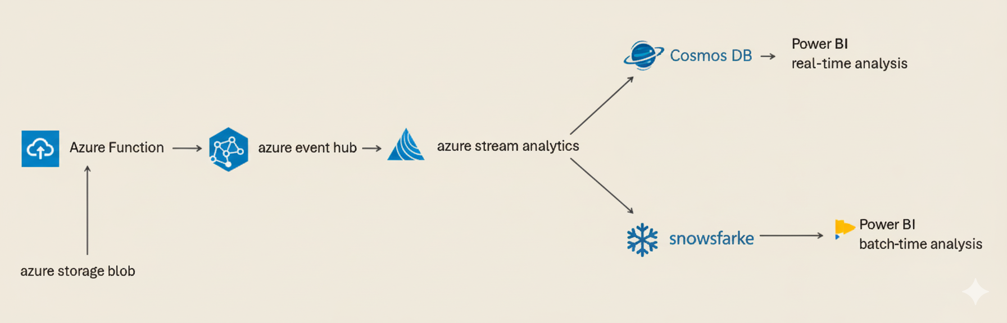



Architecture
04/08

Slide 8

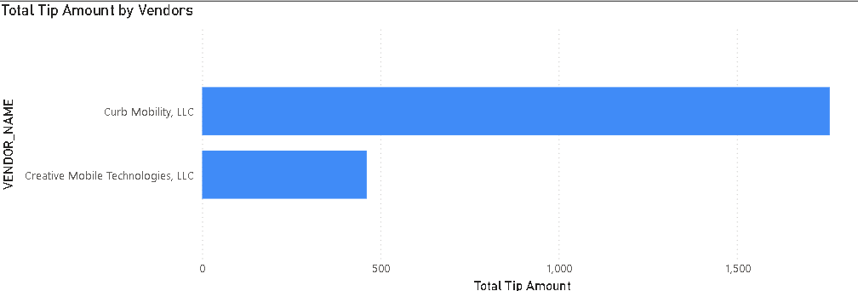
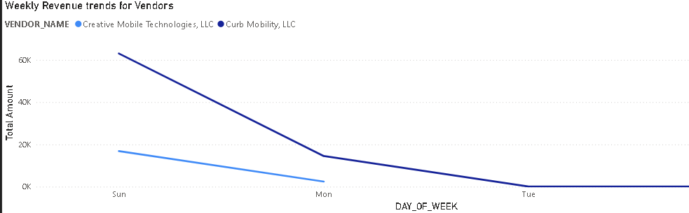
Batch visuals
05/08
Total Tip Amount For Each Vendor
Weekly Revenue trends for Vendors

Slide 9
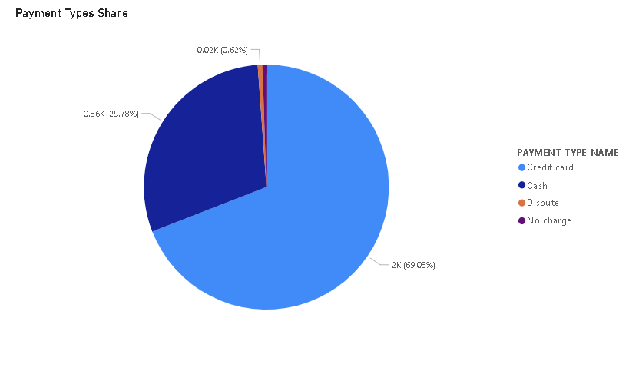
Batch visuals
05/08
Payment Types Share

Slide 10
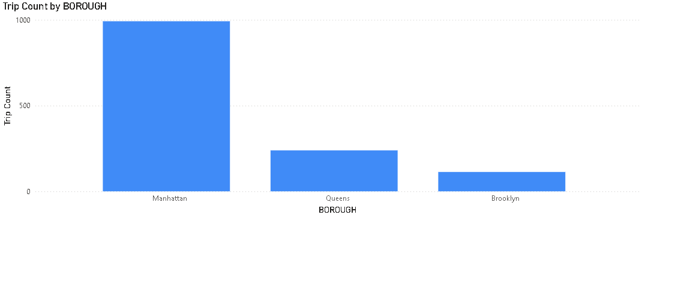
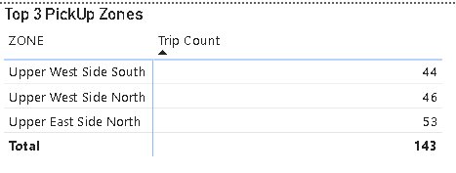
Batch visuals
05/08
Trip Count by BOROUGH
Top 3 PickUp Zones

Slide 11
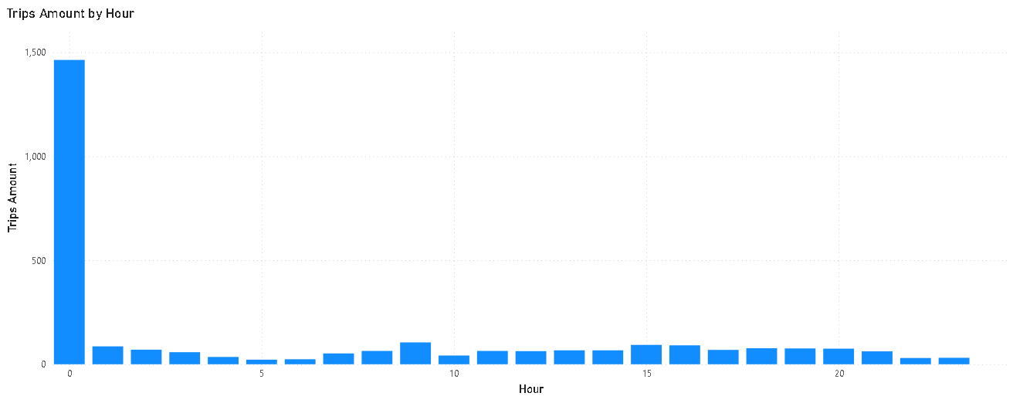
Real-Time Visuals
06/08
Total Trips per Hour

Slide 12
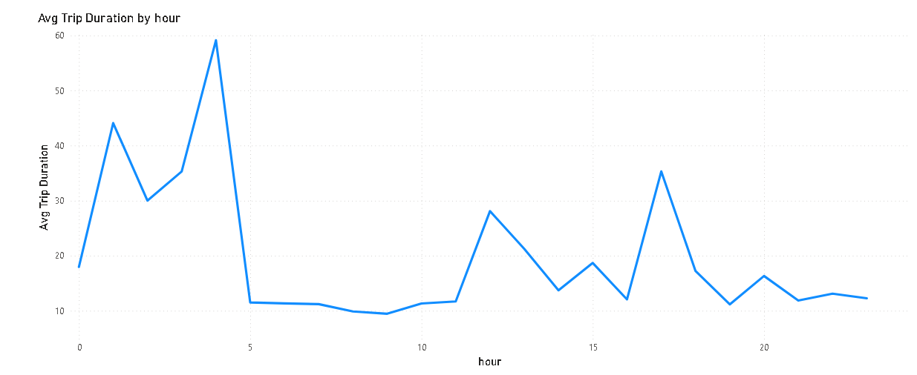
Real-Time Visuals
06/08
Avg Trip Duration In Min. Every Hour

Slide 13
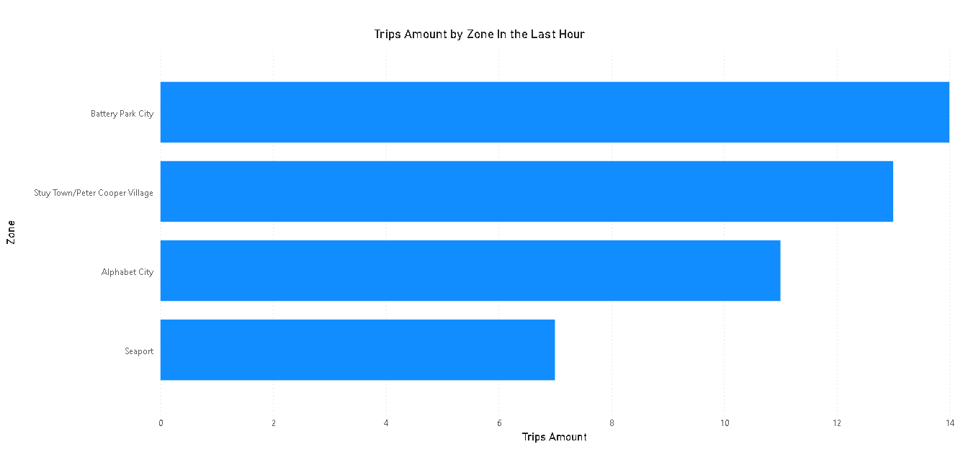
Real-Time Visuals
06/08
LastHourTrips by Zone

Slide 14
07/08
Questions?

Slide 15

08/08
Summary
Achievements: Automated ingestion, transformation, and loading, answered critical business questions, ensured data reliability with error isolation.
Future Enhancements: Integrate ML for predictive analytics (e.g., demand forecasting).

Slide 16





Thank you

